Slide 1
DataGridView Control Data Binding & LINQ

Slide 2
Objectives
DataGridView Control
Data Binding
DataView Class
LINQ

Slide 3
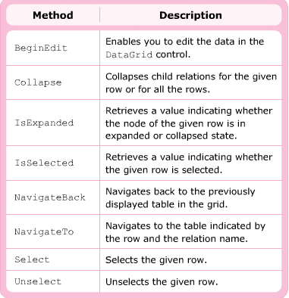
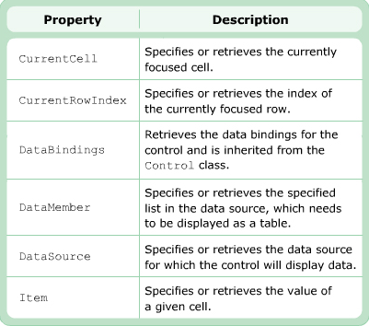
DataGrid control
Display data in a tabular format
Populated by the table present in dataSet ( binding)
Insert , delete , update → DataSet

Slide 4
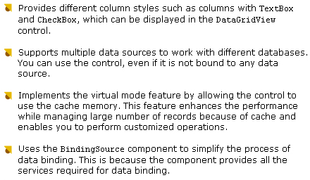
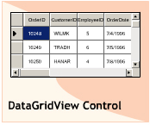
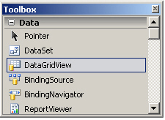
DataGridView control

Slide 5
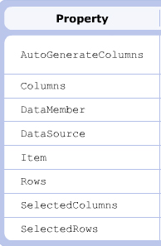
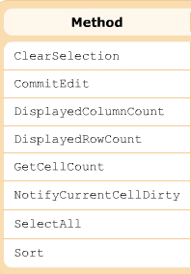
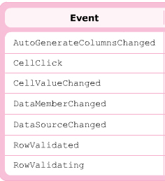
DataGridView control

Slide 6
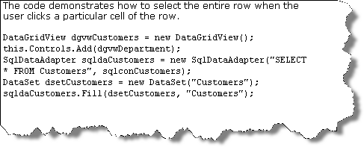
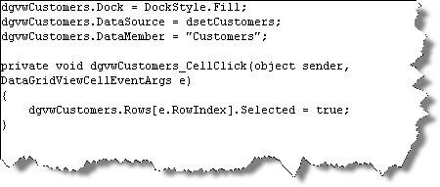
Example

Slide 7
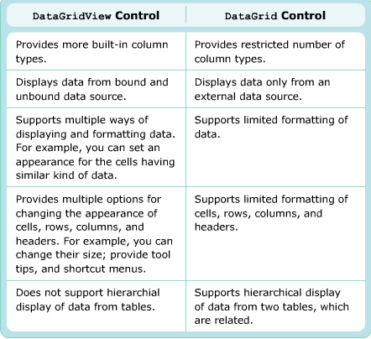
DataGridView & DataGrid control

Slide 8
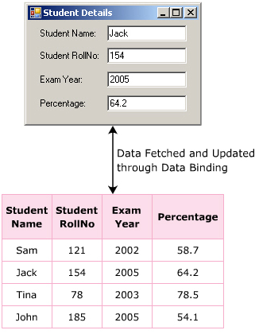
DataBinding
DataBinding is one of the most powerful features of .NET and Windows Forms.
It help in linking a control to a data source tables in the database.
This is useful to view, insert, update, and delete records in the table.

Slide 9
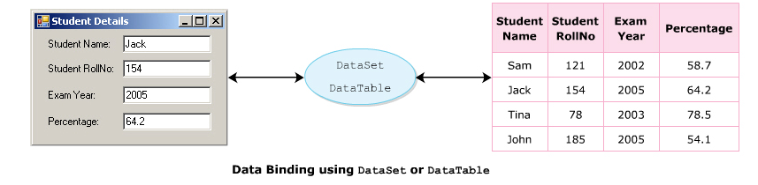
DataBinding
Allows you to create a link between the controls of the form and the database
Once the controls are linked to the database , you can retrieve data from the database.

Slide 10
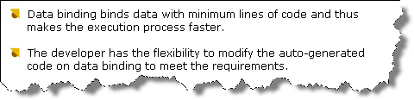
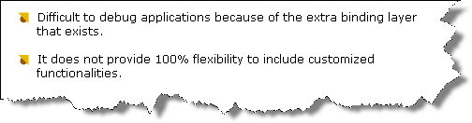
Data binding
Advantages
Disavantages

Slide 11

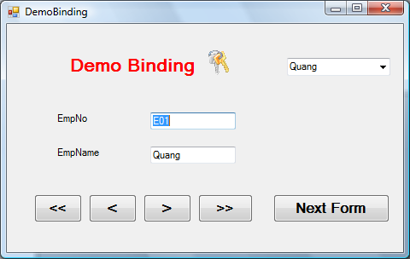
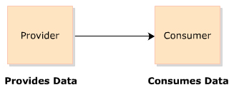
Data Provider
Consumer
Data Source
Database

Slide 12
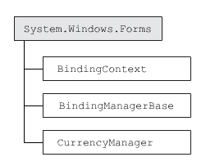
BindingContext class
BindingContext class is used to handle the BindingManagerBase objects.
Windows Form contains at leats one BindingContext Object
Properties
IsReadOnly
Item
Methods
Add
Contains
Remove
UpdateBinding
txtEmpNo.DataBindings.Add("Text" , ds.Tables["Employee"] , "EmpNo")

Slide 13
CurrencyManager class
A control which is bound to a data source is associated with a CurrencyManager.
Property | Methods | Events
Binding | CheckEmpty
Count | OnPositionChanged
Current | OnItemChanged | ItemChanged
List | AddNew | PositionChanged
Position | Refresh | ListChanged
 | RemoveAt
 | ResumeBinding
CurrencyManager bmOrders = (CurrencyManager)this.BindingContext[ds.Tables["Employee"]];
bmOrders.Position+=1;

Slide 14
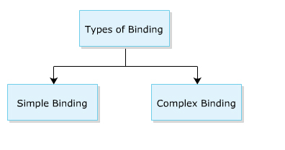
Types of Binding
Simple Binding : a property of a control is bound to a single value
Ex : TextBox with a column in table
Complex Binding : a control is associated with one or more data values
Can only be done on controls, which display more than one value at a time
Ex : comboBox

Slide 15
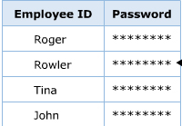
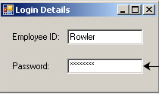
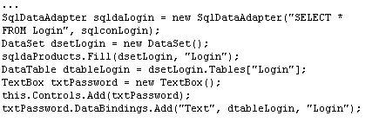
Simple Data binding

Slide 16

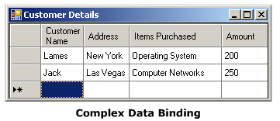
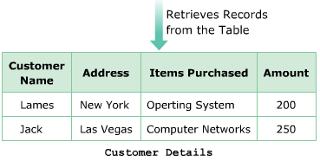
Complex data binding

Slide 17

Binding class
Properties | Methods | Events
BindAbleComponent | ReadValue | BindingComplete
BindingManagerBase | WriteValue
Control
Datasource

Slide 18
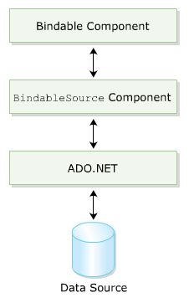
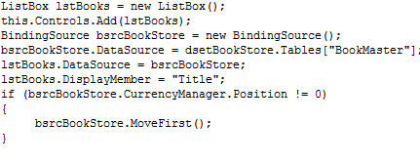
BindingSource component
Acts as a strongly typed data source
Binding the controls and data indirectly
Support data navigation , manipulation and sorting or filtering data

Slide 19
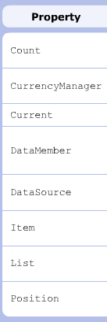
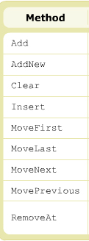
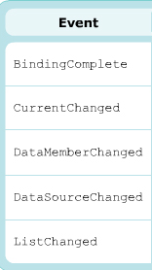
BindingSource

Slide 20
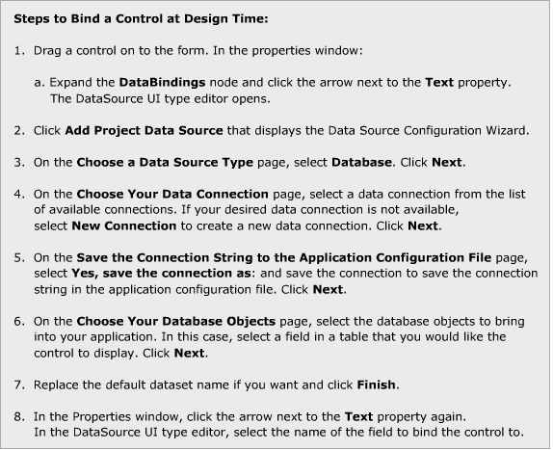
Binding a control
You can bind a control to a data source at desing time or run time.

Slide 21
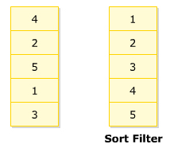
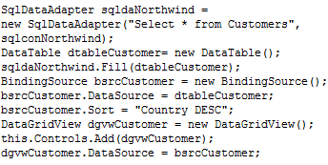
Sort property of BindingSource

Slide 22
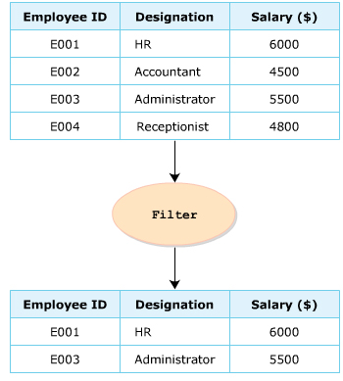
Filter property
- Filter property of the BindingSource class is used for filtering data
Ex : bClass.Filter = “Address=‘California’”

Slide 23
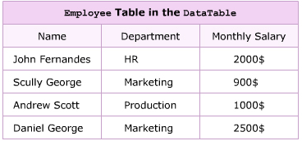
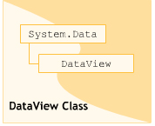
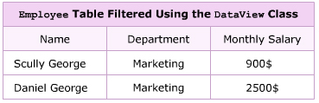
DataView class
Used to sort , filter , search , modify and navigate through the record
Constructor of this class is a dataTable

Slide 24
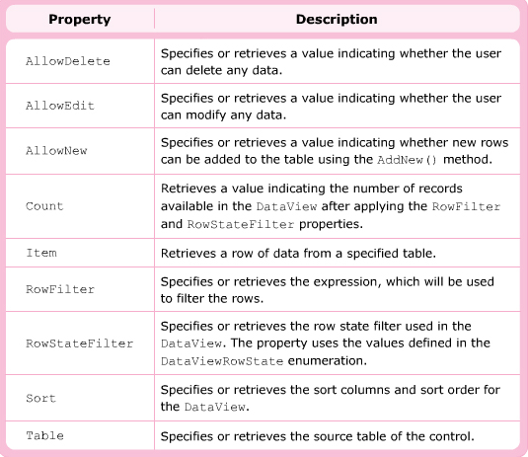
Properties

Slide 25
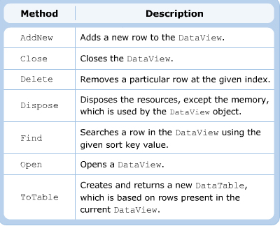
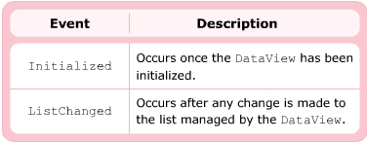

Slide 26

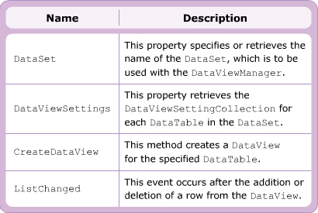
DataViewManager

Slide 27
What is the .NET Framework 3.5?
.NET Framework 3.5
LINQ
ASP.NET 3.5
CLR Add-in
Framework
Additional Enhancements
.NET Framework 3.0 + SP1
Windows Presentation Foundation
Windows Communication Foundation
Windows Workflow Foundation
Windows CardSpace
.NET Framework 2.0 + SP1

Slide 28
Language-Integrated Query (LINQ)
C# 3.0 and VB9 Language Enhancements
Building to LINQ to Objects
LINQ to XML
LINQ to SQL
LINQ to DataSets

Slide 29
Compiler Features
Most are LINQ enablers
C# 3.0
VB9
XML Literals
Anonymous Types
Collection Initializers
Anonymous Types
Extension Methods
Relaxed Delegates
Extension Methods
Automatic Properties
Lambda expressions
If Ternary Operator
Lambda expressions
Lambda statements
Object Initializers
Nullable Syntax
Object Initialisers
Local Type Inference
Local Type Inference
Partial Methods

Slide 30
Language Innovations
Query expressions
var contacts =
from c in customers
where c.City == "Hove"
select new { c.Name, c.Phone };
Local variable type inference
Lambda expressions
var contacts =
customers
.Where(c => c.City == "Hove")
.Select(c => new { c.Name, c.Phone });
Extension methods
Anonymous types
Object initializers

Slide 31
Extension methods
Add methods to existing types “virtually”
Static method with first “this” parameter
Scoping using namespaces
static class MyExtensions { public static string Reverse(string s) { char[] c = s.ToCharArray(); Array.Reverse(c); return new string(c); } }
static class MyExtensions { public static string Reverse(this string s) { char[] c = s.ToCharArray(); Array.Reverse(c); return new string(c); } }
Promoted first parameter
string name = “Bart”;
string reversed = name.Reverse();
string name = “Bart”;
string reversed = MyExtensions.Reverse(name);

Slide 32
Automatic properties
Tired of writing properties?
Compiler can generate the get/set plumbing
class Customer { private string _name; public string Name { get { return _name; }; set { _name = value; }; } }
Setter required; can be private or internal
class Customer { public string Name { get; set; } }

Slide 33
Object initializers
Ever found the constructor of your taste?
Insufficient overloads, so pick one
Call various property setters
class Customer { public string Name { get; set; } public int Age { get; set; } }
Customer c = new Customer(); c.Name = “Bart”; c.Age = 24;
Can be combined with any constructor call
var c = new Customer(){ Name = “Bart”, Age = 24};

Slide 34
Collection initializers
Arrays easier to initialize than collections?!
int[] ints = new int[] { 1, 2, 3 }; List<int> lst = new List<int>(); lst.Add(1); lst.Add(2); lst.Add(3);
int[] ints = new int[] { 1, 2, 3 }; var lst = new List<int>() { 1, 2, 3 };
Works for any ICollection class by calling its Add method

Slide 35
Anonymous types
Let the compiler cook up a type
Can’t be returned from a method
Local variable type inference becomes a must
Used in LINQ query projections
var person = new { Name = “Bart”, Age = 24 };
var customer = new { Id = id, person.Name };

Slide 36
Lambda expressions
Lambda expressions are specified as a comma-delimited list of parameters followed by the lambda operator, followed by an expression or statement block.
In C#, the lambda operator is =>. Therefore, a lambda expression in C# looks like this:
(param1, param2, …paramN) => expr
Or :
(param1, param2, …paramN) =>
{
statement1;
statement2;
…
statementN;
return(lambda_expression_return_type);
}

Slide 37
Lambda expressions
Functional-style anonymous methods
delegate int BinOp(int a, int b); int Calc(BinOp f, int a, int b) { return f(a, b) }
int result = Calc( delegate (int a, int b) { return a + b; }, 1, 2);
Parameter types inferred based on the target delegate
var result = Calc((a, b) => a + b, 1, 2);

Slide 38
First, A Taste of LINQ
using System;
using System.Query;
using System.Collections.Generic;
class app {
static void Main() {
string[] names = { "Burke", "Connor“, "Frank", "Everett", "Albert", "George",
"Harris", "David" };
var expr = from s in names
where s.Length == 5
orderby s
select s.ToUpper();
foreach (string item in expr)
Console.WriteLine(item);
}
}
BURKE
DAVID
FRANK

Slide 39
Query Expressions
Introduce SQL-Like Syntax to Language
Compiled to Traditional C# (via Extension Methods)
from itemName in srcExpr
join itemName in srcExpr on keyExpr equals keyExpr
(into itemName)?
let itemName = selExpr
where predExpr
orderby (keyExpr (ascending | descending)?)*
select selExpr
group selExpr by keyExpr
into itemName query-body

Slide 40
LINQ Architecture
Visual C#
Visual Basic
Others
.Net Language Integrated Query (LINQ)
LINQ-enabled data sources
LINQ-enabled ADO.NET
LINQ
To Objects
LINQ
To Datasets
LINQ
To SQL
LINQ
To Entities
LINQ
To XML
<book>
<title/>
<author/>
<price/>
</book>
Objects
Databases
XML
Notes:
5/31/2017 07:49 AM
40
©2005 Microsoft Corporation. All rights reserved.
This presentation is for informational purposes only. Microsoft makes no warranties, express or implied, in this summary.

Slide 41
LINQ to Objects
Native query syntax in C# and VB
IntelliSense
Autocompletion
Query Operators can be used against any .NET collection (IEnumerable<T>)
Select, Where, GroupBy, Join, etc.
Deferred Query Evaluation
Lambda Expressions
using System;
using System.Query;
using System.Collections.Generic;
class app {
static void Main() {
string[] names = { "Allen", "Arthur", "Bennett" };
IEnumerable<string> ayes = names
.Where(s => s[0] == 'A');
foreach (string item in ayes)
Console.WriteLine(item);
names[0] = "Bob";
foreach (string item in ayes)
Console.WriteLine(item);
}
}
Arthur
using System;
using System.Query;
using System.Collections.Generic;
class app {
static void Main() {
string[] names = { "Allen", "Arthur", "Bennett" };
IEnumerable<string> ayes = names
.Where(s => s[0] == 'A');
foreach (string item in ayes)
Console.WriteLine(item);
names[0] = "Bob";
foreach (string item in ayes)
Console.WriteLine(item);
}
}
Allen
Arthur
using System;
using System.Query;
using System.Collections.Generic;
class app {
static void Main() {
string[] names = { "Burke", "Connor", "Frank", "Everett", "Albert", "George",
"Harris", "David" };
IEnumerable<string> expr =
from s in names
where s.Length == 5
orderby s
select s.ToUpper();
foreach (string item in expr)
Console.WriteLine(item);
}
}
BURKE
DAVID
FRANK
using System;
using System.Query;
using System.Collections.Generic;
class app {
static void Main() {
string[] names = { "Burke", "Connor", "Frank", "Everett", "Albert", "George",
"Harris", "David" };
Func<string, bool> filter = s => s.Length == 5;
Func<string, string> extract = s => s;
Func<string, string> project = s => s.ToUpper();
IEnumerable<string> expr = names
.Where(filter) .OrderBy(extract)
.Select(project);
foreach (string item in expr)
Console.WriteLine(item);
}
}
BURKE
DAVID
FRANK

Slide 42
LINQ Architecture
Visual C#
Visual Basic
Others
.Net Language Integrated Query (LINQ)
LINQ-enabled data sources
LINQ-enabled ADO.NET
LINQ
To Objects
LINQ
To Datasets
LINQ
To SQL
LINQ
To Entities
LINQ
To XML
<book>
<title/>
<author/>
<price/>
</book>
Objects
Databases
XML
Notes:
5/31/2017 07:49 AM
42
©2005 Microsoft Corporation. All rights reserved.
This presentation is for informational purposes only. Microsoft makes no warranties, express or implied, in this summary.

Slide 43
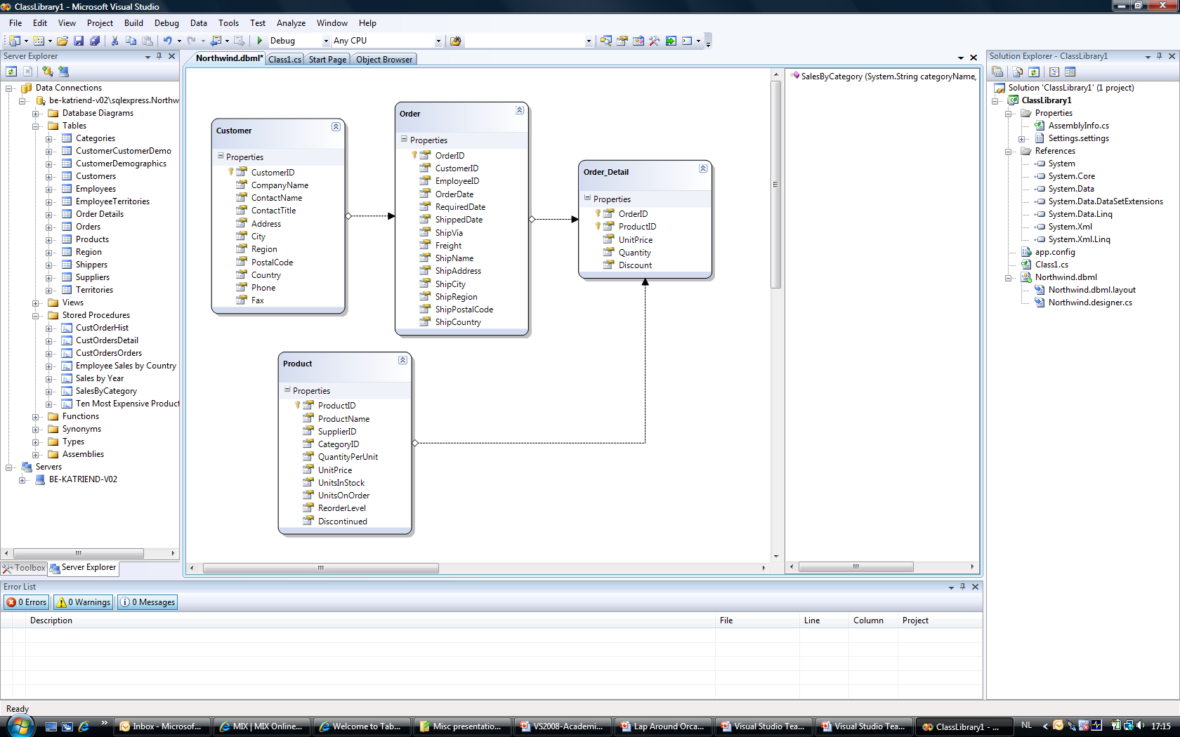
LINQ to SQL Overview

Slide 44
LINQ to SQL Architecture
from c in db.Customers
where c.City == "London"
select c.CompanyName
db.Customers.Add(c1);
c2.City = “Seattle";
db.Customers.Remove(c3);
Application
Enumerate
Objects
SubmitChanges()
LINQ to SQL
SQL Query or SProc
Rows
DML or SProcs
SELECT CompanyName
FROM Customer
WHERE City = 'London'
SQL Server
INSERT INTO Customer …
UPDATE Customer … DELETE FROM Customer …

Slide 45
LINQ to SQL
DataContext is the central class
Use code-gen for ORM
SQL is only submitted when needed
Parent-child relationships are respected
Control of deferred loading
Can insert/update/delete
Transactionally, with concurrency checks

Slide 46
LINQ to DataSet
Query expressions over in-memory data
Works with untyped or typed DataSets
If query returns some kind of DataRow: -
Can yield results as a DataView
...and therefore databind to those results

Slide 47
LINQ Architecture
Visual C#
Visual Basic
Others
.Net Language Integrated Query (LINQ)
LINQ-enabled data sources
LINQ-enabled ADO.NET
LINQ
To Objects
LINQ
To Datasets
LINQ
To SQL
LINQ
To Entities
LINQ
To XML
<book>
<title/>
<author/>
<price/>
</book>
Objects
Databases
XML
Notes:
5/31/2017 07:49 AM
47
©2005 Microsoft Corporation. All rights reserved.
This presentation is for informational purposes only. Microsoft makes no warranties, express or implied, in this summary.

Slide 48

LINQ to XML
Creating XML
Constructors lend themselves to nesting
Can use LINQ (over anything) to build XML
Querying
Use normal axes from XML infoset
Get full power of query expressions over XML
Select, where, group by, etc.
Xml Namespaces

